Slide 1
VMware vSphere7 Troubleshooting
Information Service
Duncan Huang

Slide 2
Virtual Network
Storage
Cluster
Virtual Machine
vCenter / ESXi

Slide 3


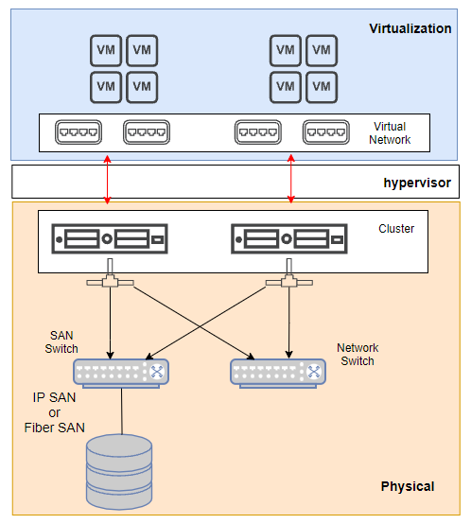

Slide 4
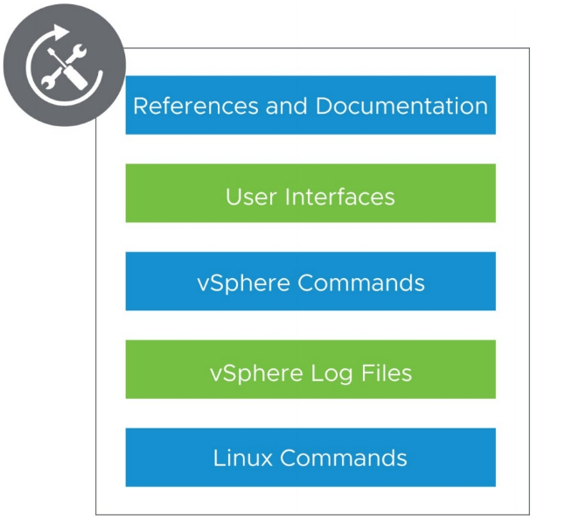
vSphere Troubleshooting Toolkit

Slide 5
References and Documentation
VMware knowledge base:
https://kb.vmware.com
VMware documentation:
https://docs.vmware.com
VMware blogs:
https://blogs.vmware.com
VMware community forums:
https://communities.vmware.com
VMware Compatibility Guide:
Product Interoperability Matrices:
vSphere 7 release notes:
https://docs.vmware.com/en/VMware-vSphere/7.0/rn/vsphere-esxi-vcenter-server-70-release-notes.html
https://www.vmware.com/resources/compatibility
https://www.vmware.com/resources/compatibility/sim/interop_matrix.php

Slide 6
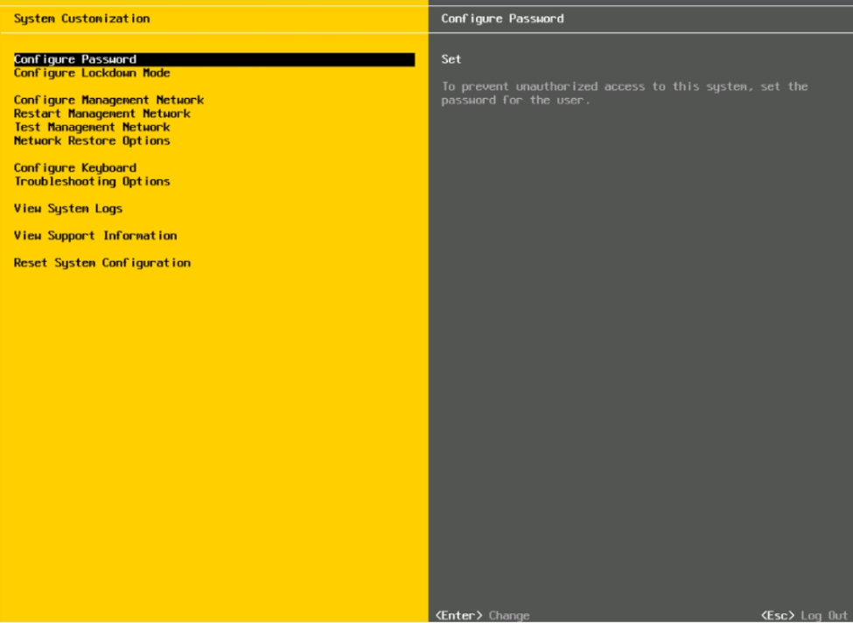
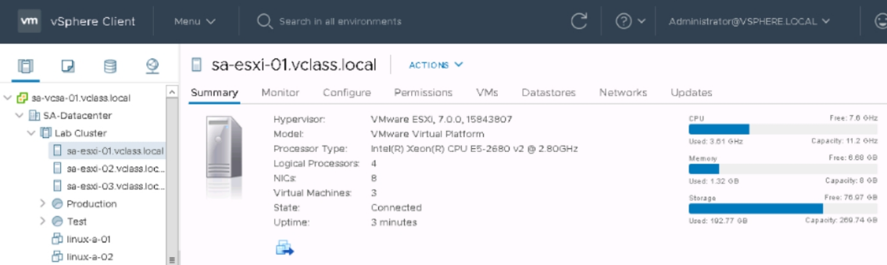
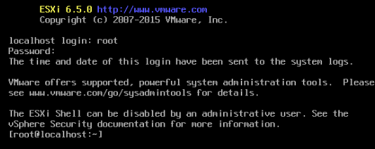
User Interface

Slide 7
Commands
• DCUI to the ESXi host and press
ALT + F1 to access vSphere ESXi Shell
• Use Standalone ESXCLI remotely

Slide 8
ESXi Log
Path | purpose
/var/log/hostd.log | Host management service log
/var/log/vobd.log | VM related information
/var/log/vmkernel.log | Core VMkernel logs device discovery, storage, networking and virtual machine startup
/var/log/syslog.log | service initialization, watchdogs, scheduled tasks, and DCUI

Slide 9
vCenter Log
Path | Purpose
/var/log/vmware/applmgmt/applmgmt.log | VMware Appliance Management Service
/var/log/vmware/sca/sca.log | VMware Service Control Agent
/var/log/vmware/vmafdd/vmafdd.log | VMware Authentication Framework Daemon
/var/log/vmware /vsphere-ui/logs/vsphere_client_virgo.log | vSphere Client

Slide 10
esxtop
Enter letter | Purpose
N | uplinks
D | adapter information
U | storage devices (LUNs)
V | VM disk activity
F | display the Fields menu

Slide 11
Virtual Network
Storage
Cluster
Virtual Machine
vCenter / ESXi

Slide 12
Networking Troubleshooting Overview
Virtual switch connectivity
Standard switches
Distributed switches
Port group
Virtual machine network connectivity
ESXi host management network connectivity

Slide 13
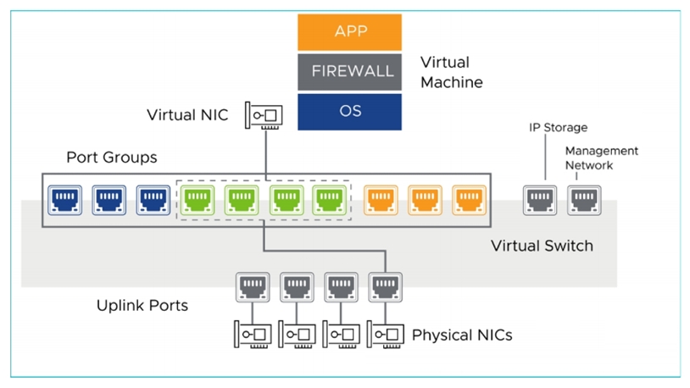

Slide 14
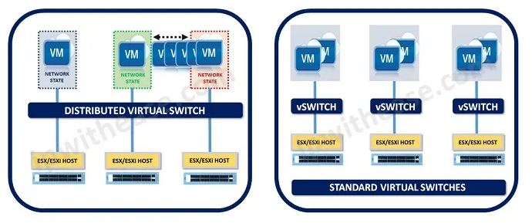
vDS vs vSS

Slide 15
Command | Description
vmkping | vmkping -I <vmk> <IP_address>
traceroute | traceroute <IP_address>
nslookup | nslookup <FQDN>

Slide 16
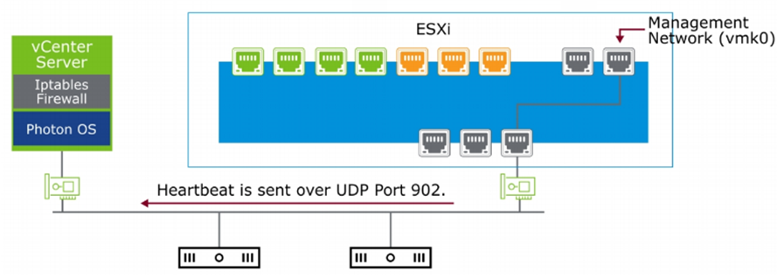
Hearbeat Between vCenter and ESXi
ESXi sent heartbeat ever 10 sec
UDP port 902
vCenter received in 60 sec

Slide 17
Reference
LAB 5
LAB 6
LAB 7
LAB 8

Slide 18
Virtual Network
Storage
Cluster
Virtual Machine
vCenter / ESXi

Slide 19
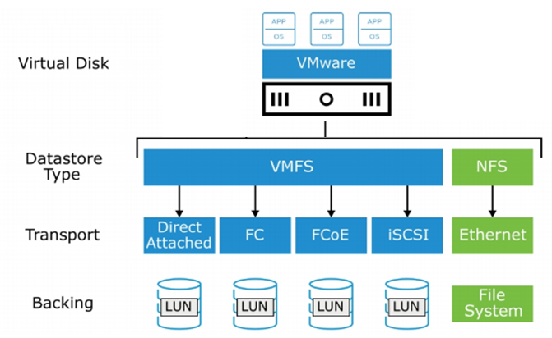
vSphere Storage Architecture
Local / iSCSI / Fiber / NFS

Slide 20
Identifying iSCSI Possible Causes
• The vmkernel misconfigured
• iSCSI TCP port 3260 is unreachable
• Firewall
• The LUN is not presented to the ESXi host

Slide 21
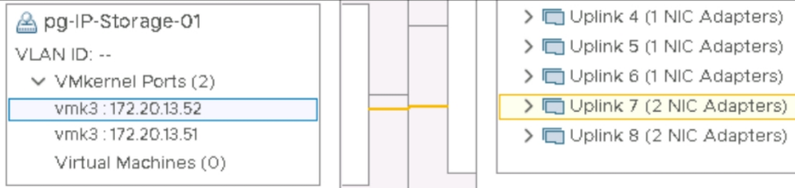
review vmkernel configuration
Is IP setting correct
Is the port group uplink correct
Ping <target_IP>
nc –z <target_IP> <3260>

Slide 22
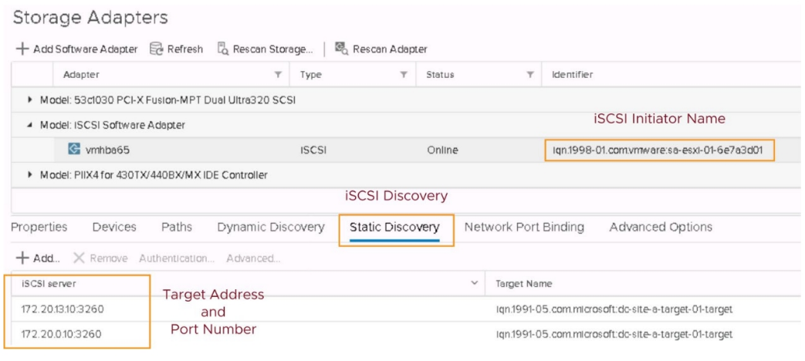
iSCSI initiator configuration

Slide 23
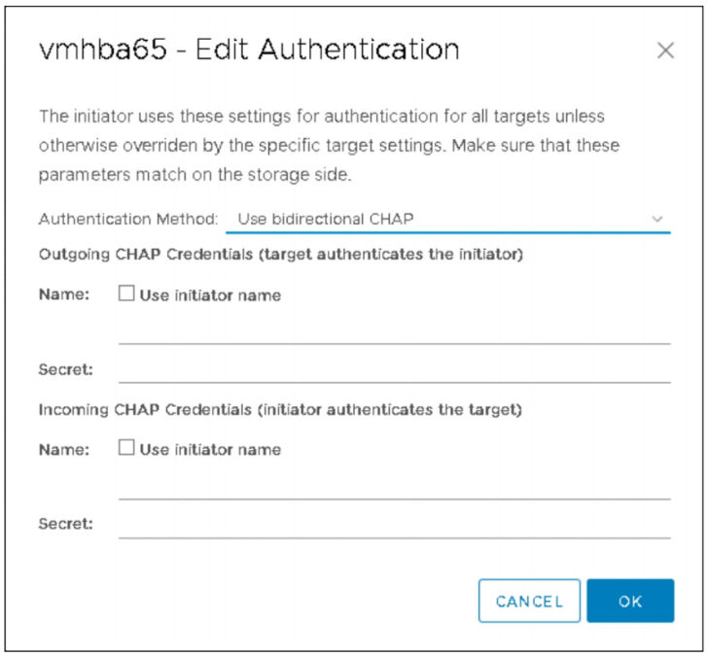
CHAP Authentication

Slide 24
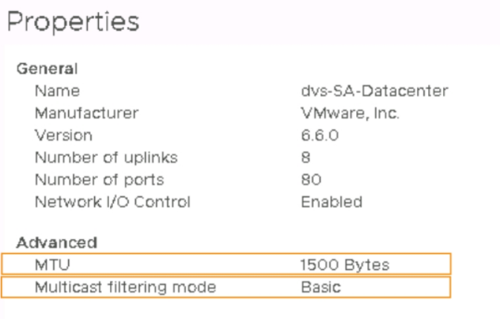
Virtual Switch Configuration

Slide 25
iSCSI Storage Performance
esxtop > enter D
Monitoring Metrics | Description
DAVG | Device to service a single I/O request (read or write) < 10 the system is healthy > 20 most likely indicates a problem
KAVG | CPU to manage I/O this value should be close to 0 1 or 2 is considered high
GAVG | Total latency seen from the virtual machine GAVG = DAVG + KAVG

Slide 26
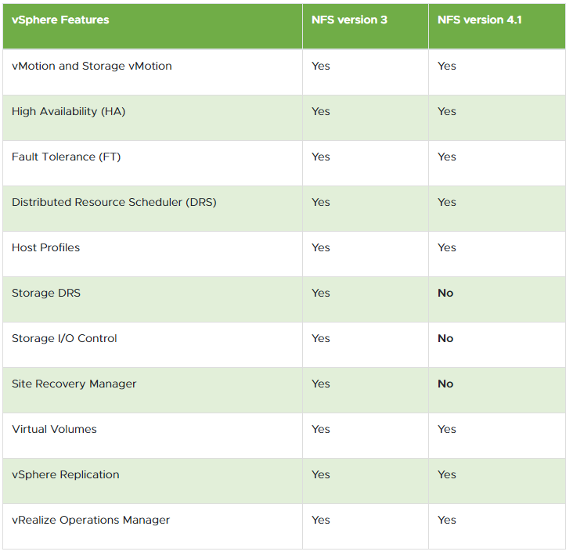
NFS Protocols and vSphere Solutions

Slide 27
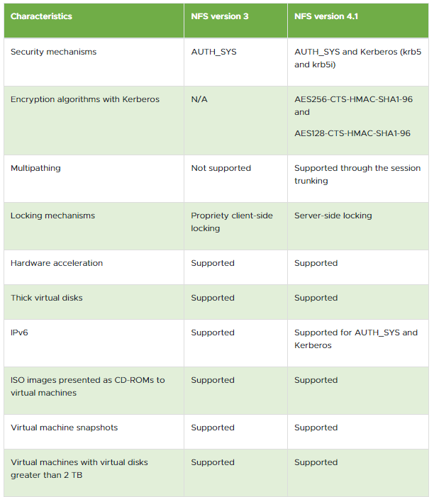
Comparing Versions of NFS Clients

Slide 28
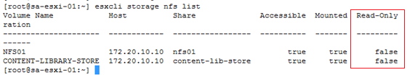
Notices for NFS
NFS v3 and v4.1 use different locking semantics
NFS v3：client-side locking
NFS v4.1 ：server-side locking
Best practices
Use same version to mount the same NFS share across all ESXi hosts in a cluster
NFS mode
Read only / Read Write

Slide 29
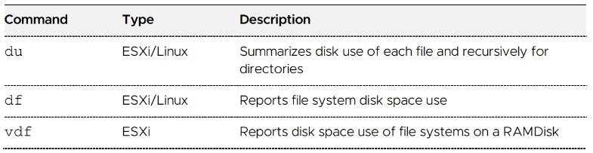
Command for Monitoring Disk Space

Slide 30
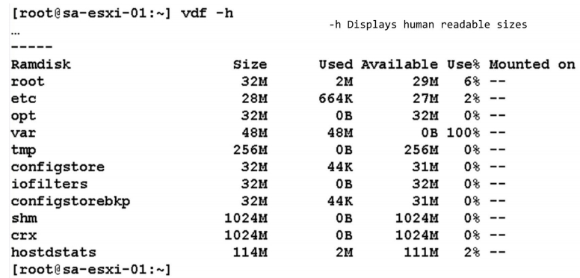
Disk Space of RAMDisk
The ramdisk “var” is full. As a result, the file /testfile could not be written

Slide 31
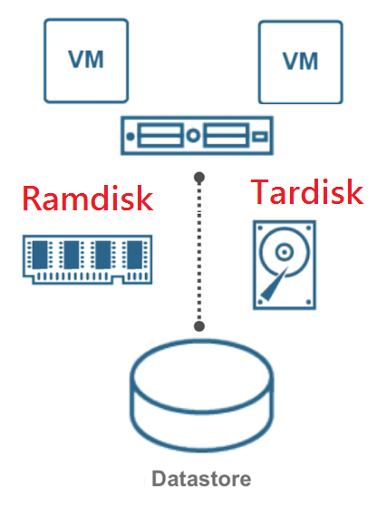
ESXi Tardisks and Ramdisks
Ramdisk
copy of the tardisk
read/write
Tardisk
system file
read only
can’t be changed
system sees only the last one available

Slide 32
Reference
LAB 9
LAB 10
LAB 11
LAB 12
LAB 13
LAB 14

Slide 33
Virtual Network
Storage
Cluster
Virtual Machine
vCenter / ESXi

Slide 34
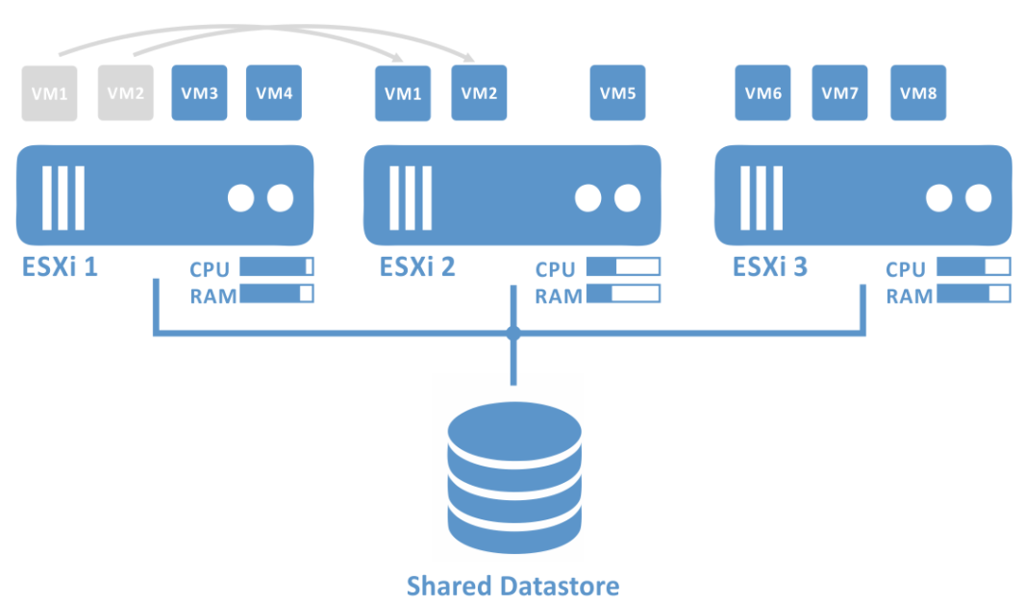
HA / DRS
High Availability
Distributed Resource Scheduler

Slide 35
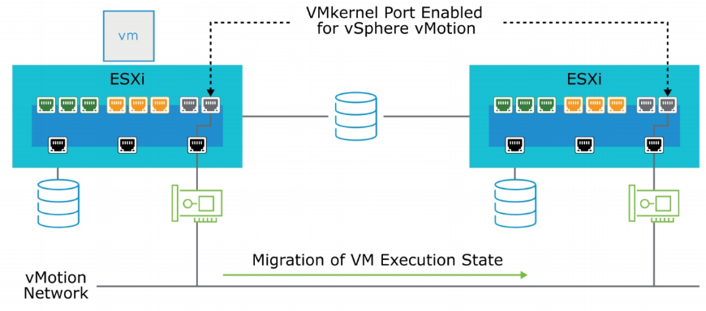
Review vMotion

Slide 36
Reference
LAB 15

Slide 37
Virtual Network
Storage
Cluster
Virtual Machine
vCenter / ESXi

Slide 38
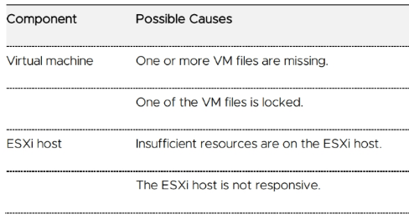
Identifying Possible Cause of VM issue

Slide 39
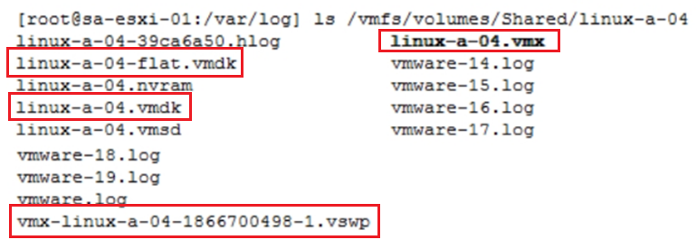
Possible Cause：VM File Missing
VMX：VM’s configuration file
VSWAP： overhead memory reserved for the VMX process
VMDK：VM’s Virtual Disk Description
flat.vmdk：VM’s Virtual Disk

Slide 40
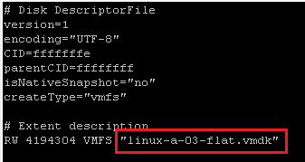
File vmdk was not found
re-build VMDK
ls -al xxxx-flat.vmdk
cat xxxx.vmx | grep virtualDev
vmkfstools -c <vmdk_size> -a <virtual_Dev> -d thin temp.vmdk
mv temp.vmdk xxxx.vmdk
vi xxxx.vmdk

Slide 41
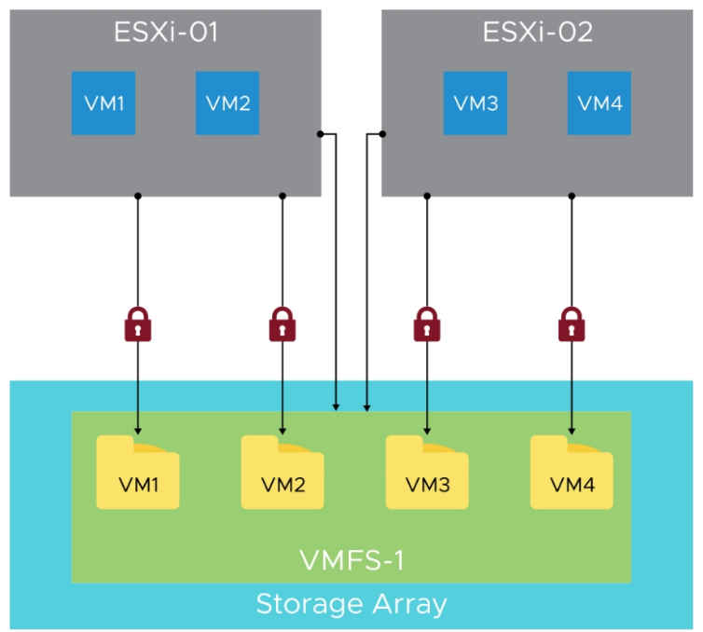
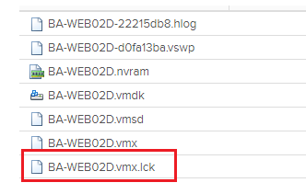
ESXi File Locking

Slide 42
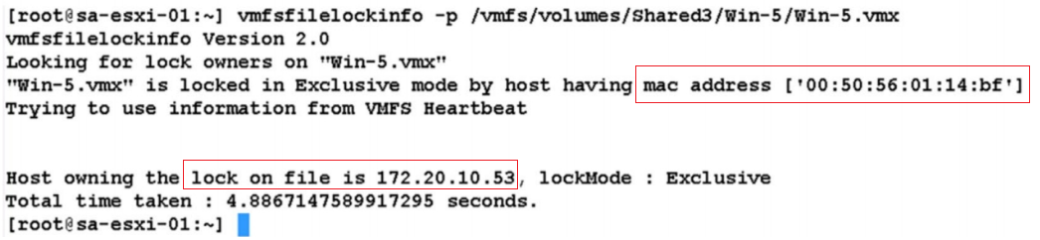
vmfsfilelockinfo -p <name of locked VM file>

Slide 43
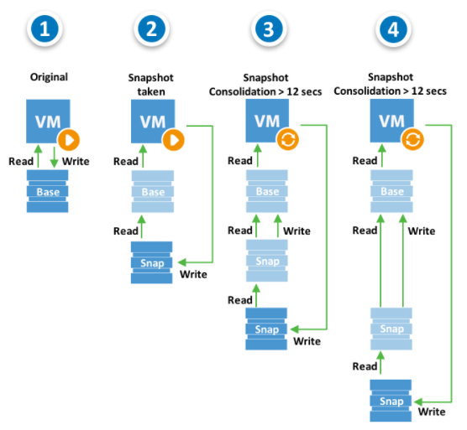
How snapshot working

Slide 44
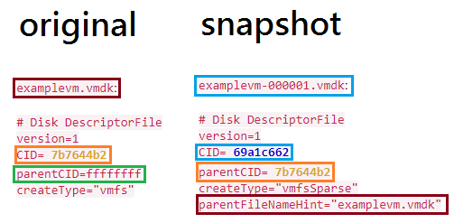
Snapshot relationship

Slide 45
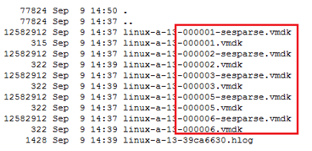
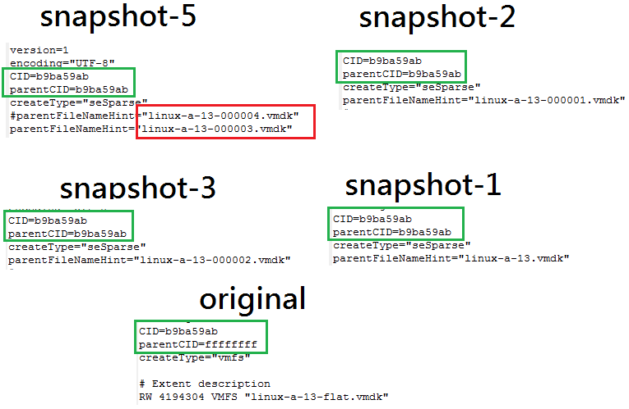
Snapshot Troubleshooting

Slide 46
Reference
LAB 16
LAB 17

Slide 47
Virtual Network
Storage
Cluster
Virtual Machine
vCenter / ESXi

Slide 48
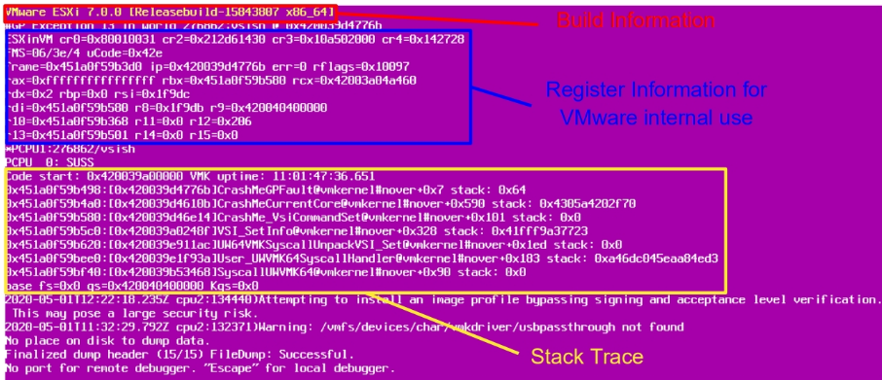
ESXi host failure

Slide 49
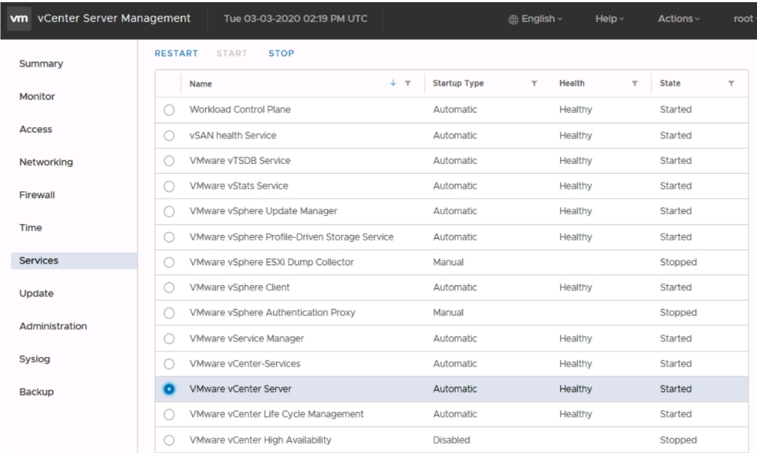
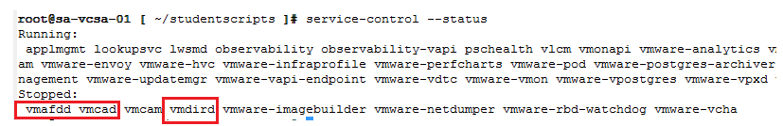
vCenter Service Status
https://vCenter-FQDN:5480
check service purpose by here

Slide 50
Reference
LAB 18
LAB 19
LAB 20
LAB 21

